Slide 1

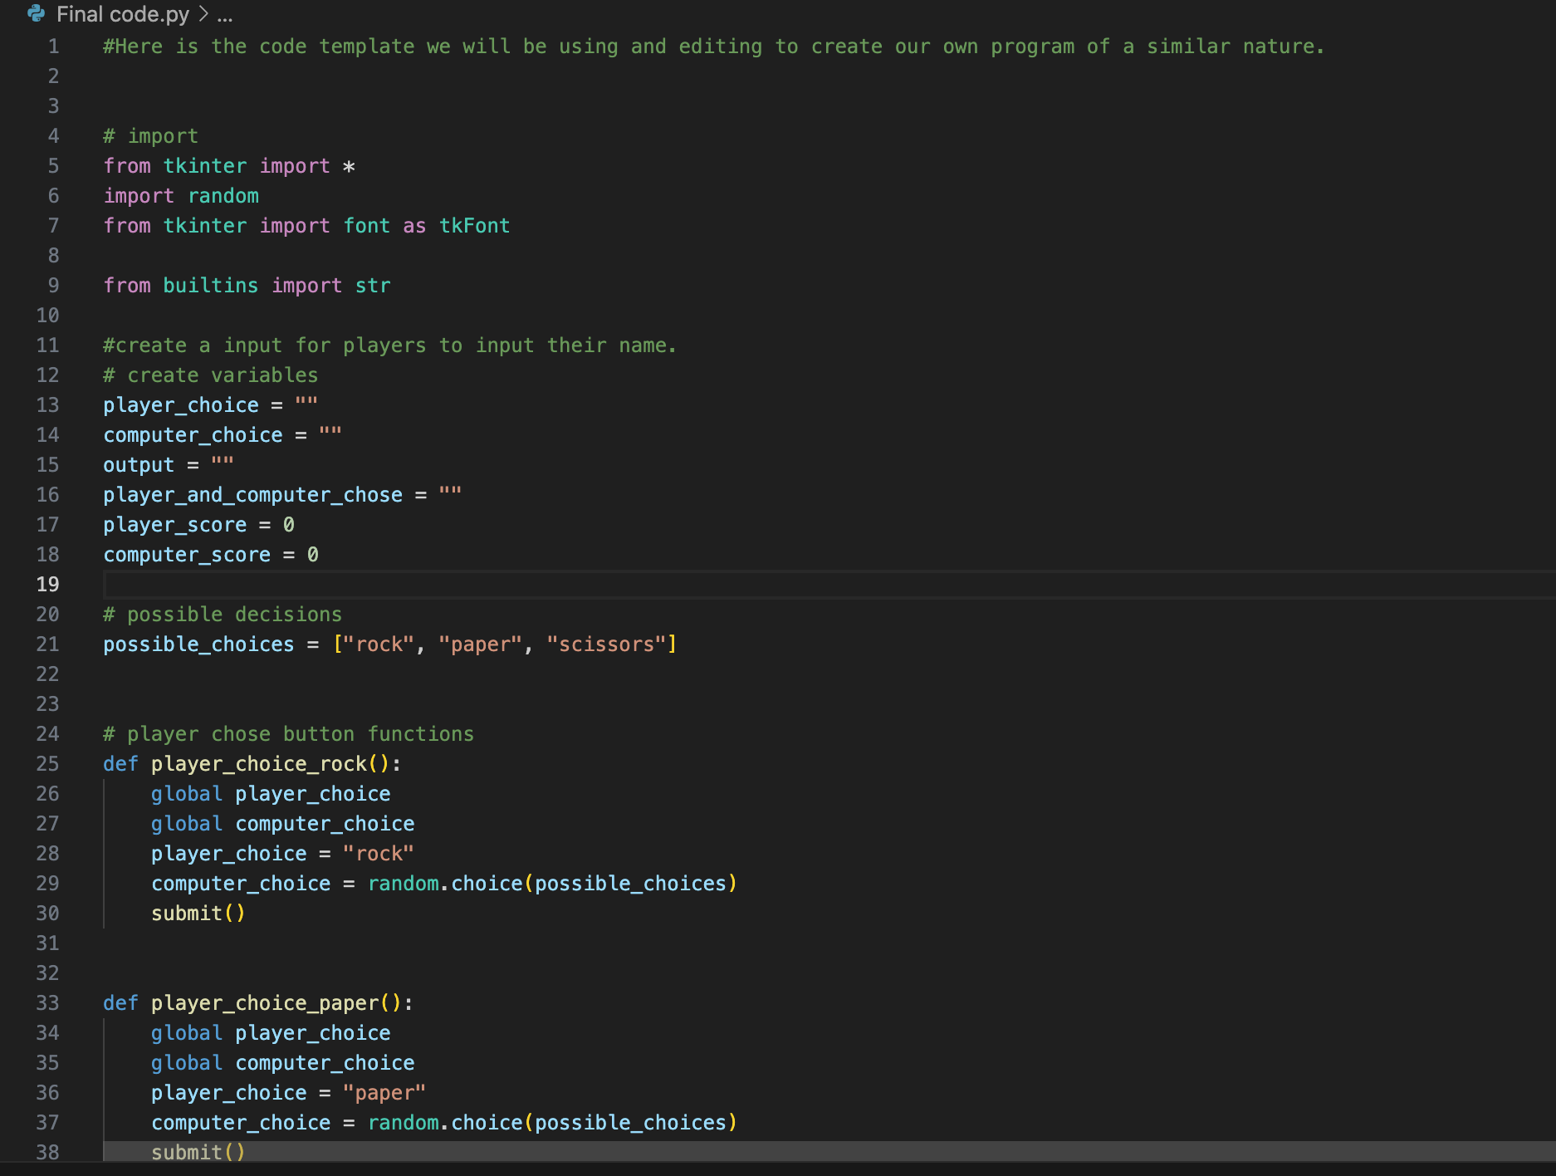
Rock-Paper-scissors
Marissa McIlhany
Unleash the power of code with the ultimate Computer
Vs. Player Rock-Paper-Scissors Game

